Slide 1
দিবস পঞ্জিকা
konika paul 151-15-4757 tapan Chandra Sarkar 151-15-4860 Md. SHAMSUZZAMAN 151-15-4861 MOSTOFA AHMED 151-15-4964 Mariya Rahman 151-15-5317

Slide 2
Feature
Motivation of this project
Objective of this project
Platforms of this project
Expected outcome from this project

Slide 3
Motivation of this project
Easy to know about all government holidays and important days
User friendly
Consume our time
Notify us automatically

Slide 4
Platforms of this project
Android studio
Java
Xml

Slide 5
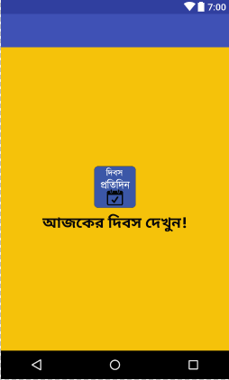
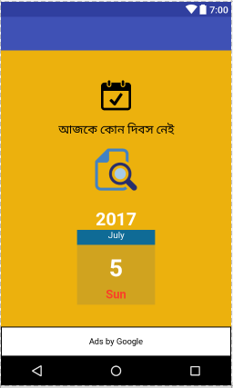
Objective of this project
Layouts

Slide 6
Permissions …..

Slide 7
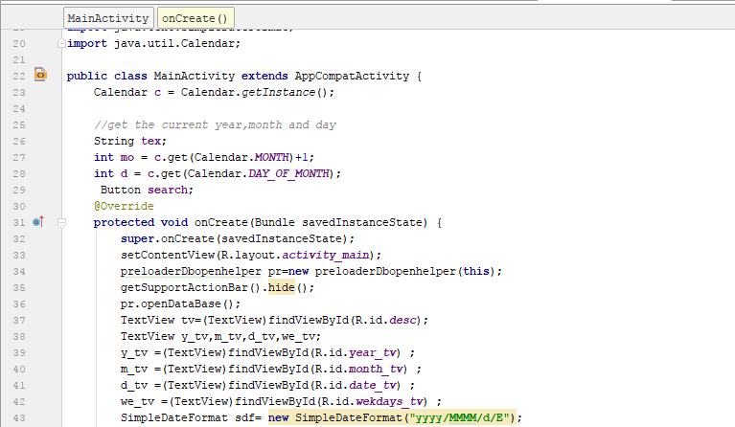
MainActivity.java

Slide 8
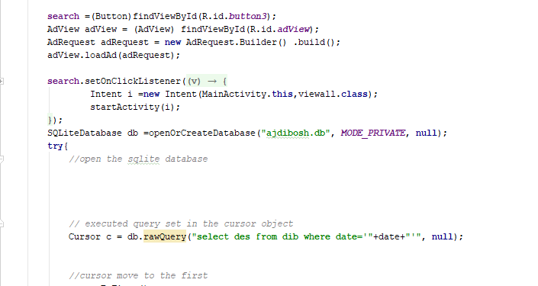
MainActivity.java

Slide 9
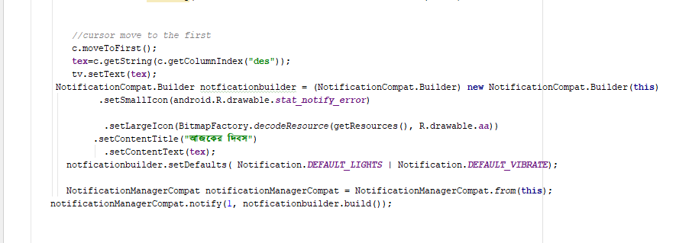
MainActivity.java

Slide 10
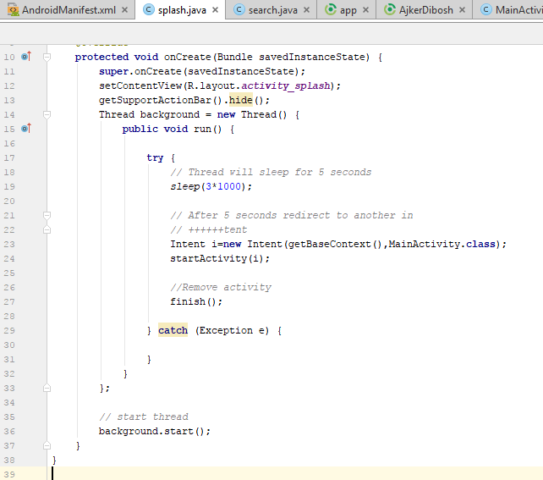
Splash…

Slide 11
Expected outcome from our project
Help People to know easily about the important days.
But have some limitations
now its only in Bangla version
limited data
haven't note reminder feature

Slide 12
Future benefits
In this project our next step is to update it into English version increase our database so that we can use it internationally
Overcome our limitations as like including custom notes reminder so that this app can notify us all the important information's of that day.
It will help people to makes their life easier than before.

Slide 13
Thank
You

